Slide 1
Neighborhoods in Novi, MI
Applied Data Science Capstone Project Report
Maria Usina

Slide 2
The city of opportunities
Novi is a city in Oakland County in the U.S. state of Michigan. The city is located approximately 25 miles northwest of the center of Detroit.
The location of Novi is great in Michigan, it is close to all Big-3 companies, and it also commutes easily to all other major companies in Michigan.
Novi is the one of the fastest growing cities in Michigan today

Slide 3
Data Collection and Cleaning
Most data and information about the City of Novi can be found in the City of Novi Open Data Center:
https://www.opendatanetwork.com/entity/1600000US2659440/Novi_MI/
Use Beautiful Soup to pull data out of HTML and XML files, and parsed data to
find ways of navigating and searching the useful information.
Use json library to convert parsed data into lists or dictionaries
Combine all related lists and dictionaries into
different DataFrame by using Pandas library.
Drop all missing values in the DataFrame and reorganize some DataFrame

Slide 4
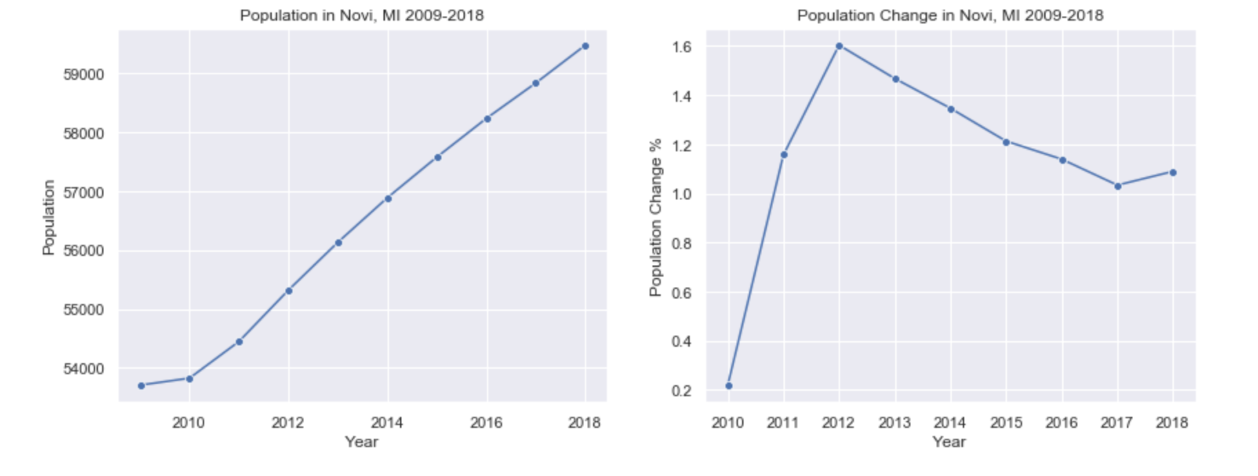
Population Increases Continuously While the City Is Growing

Slide 5
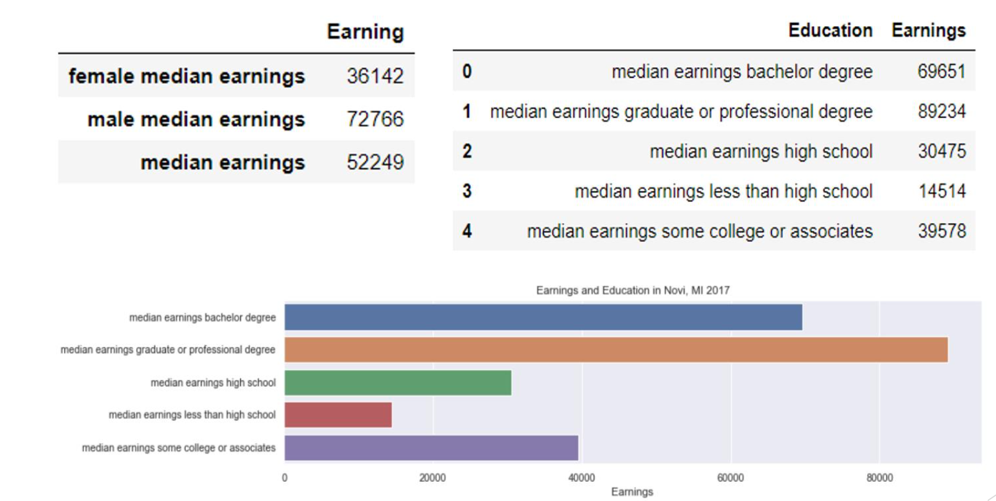
More People with High Income and Education Move to Novi

Slide 6
City Debt VS. Revenue
Debt refers to the total amount of outstanding dollars owed by a government entity.
Debt Per Capita is the amount of outstanding debt per resident.
Long Term Debt is the unmatured principal of bonds, or other forms of
noncurrent or long-term obligation indebtedness.
Debt Service Ratio is the percentage of annual revenues committed to paying back debts.
Debt as a Percentage of Taxable Value is the amount of long term debt
compared to taxable value.
Long Term Debt Revenue is the ratio of outstanding long term debts to revenues.

Slide 7
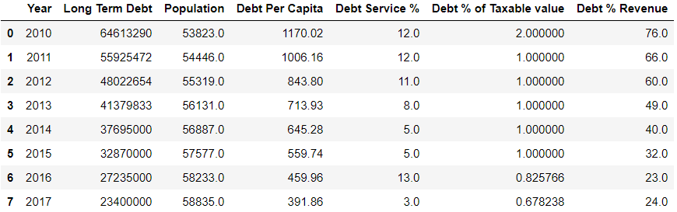
City Debt VS. Revenue

Slide 8
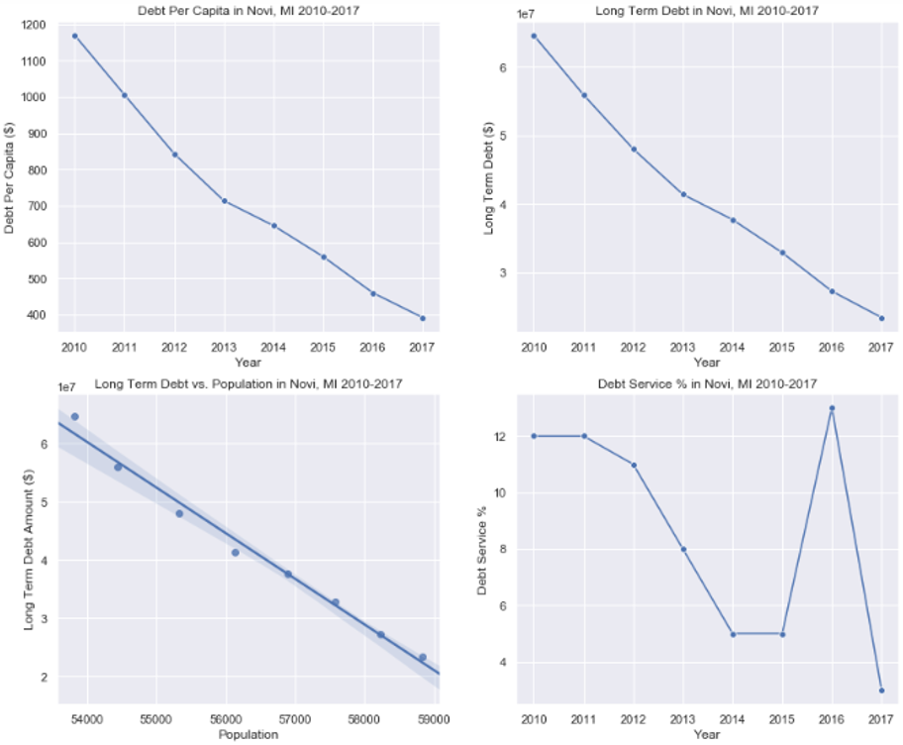
City Debt VS. Revenue

Slide 9
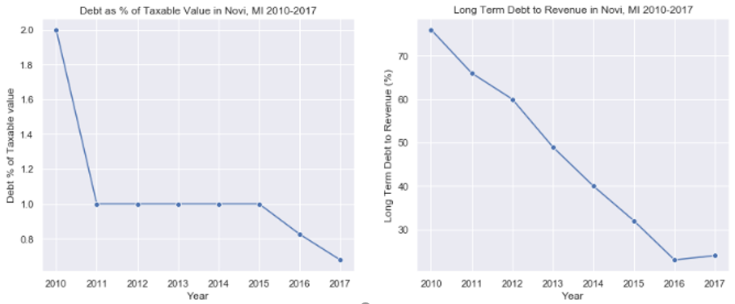
City Debt VS. Revenue

Slide 10
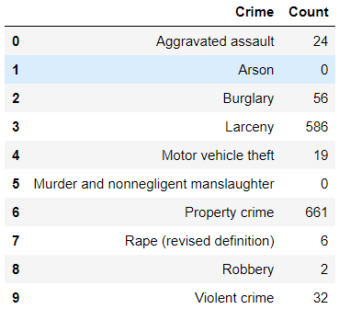
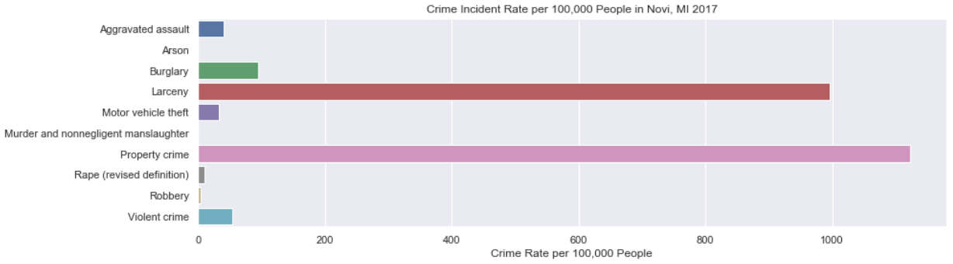
Low Crime Incident Rate

Slide 11
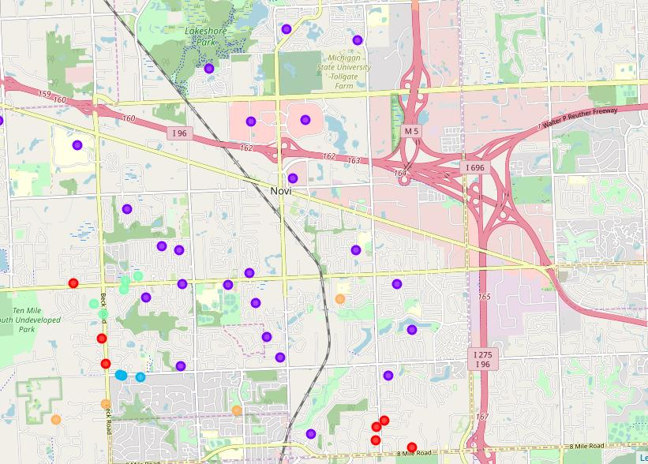
Clustering of Neighborhoods in Novi
Use the k-means clustering algorithm to group the neighborhoods into clusters
Use the Folium library to visualize the neighborhoods in Novi

Slide 12
Results
Data shows more and more high income and education population come and live in Novi in the past 10 years. At the same time, more and more business opportunities occurs, and the city has more revenue and less debt while the city is growing. Also, the high population does not increase the crime incident significantly. The crime incident per population density is still very low.
Overall, Novi is the one of the best city to live in Michigan and it is also the one of the fastest growing city. Better living condition, school district and safety will attract more high income and education people move to Novi, then those people will bring more benefit and opportunities to the city. It is a great virtuous cycle.

Slide 13
Discussion
There are more and more business opportunities in Novi. Based on the data analysis, machine learning and cluster visualization, we can see that maybe the best place to open a coffee shop will be at the section of Ten Mile Rd and Novi Rd.
The reasons are: 1. The center of the city. 2. A lot of subdivisions locate around that section. 3. Close to the entry of the heavily used highway in Novi.

